Slide 1

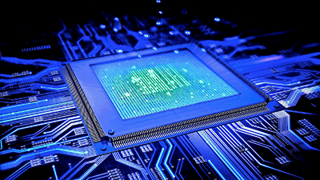
Introduction to Digital Systems
EGR 226
Lecture_9
Dr. Nabeeh Kandalaft EGR226 Grand valley State University

Slide 2
Topic for today’s lecture
write C code to control pixels on an LCD matrix display
describe the concept of structured design
describe Unified Markup Language tools developed for system design
produce a UML state diagram to describe your project design concept
produce a specifications requirements document
begin work on your embedded system design document
Dr. Nabeeh Kandalaft EGR226 Grand valley State University

Slide 3
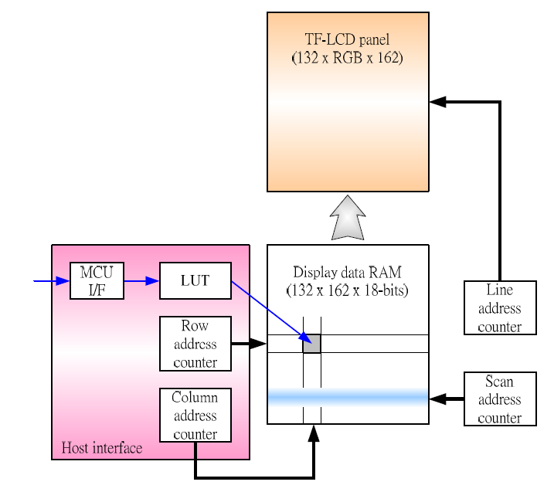
The ST7735R TFT LCD Controller/Driver
From: ST7735R single-chip controller/driver data sheet
Notes:
Look up table

Slide 4
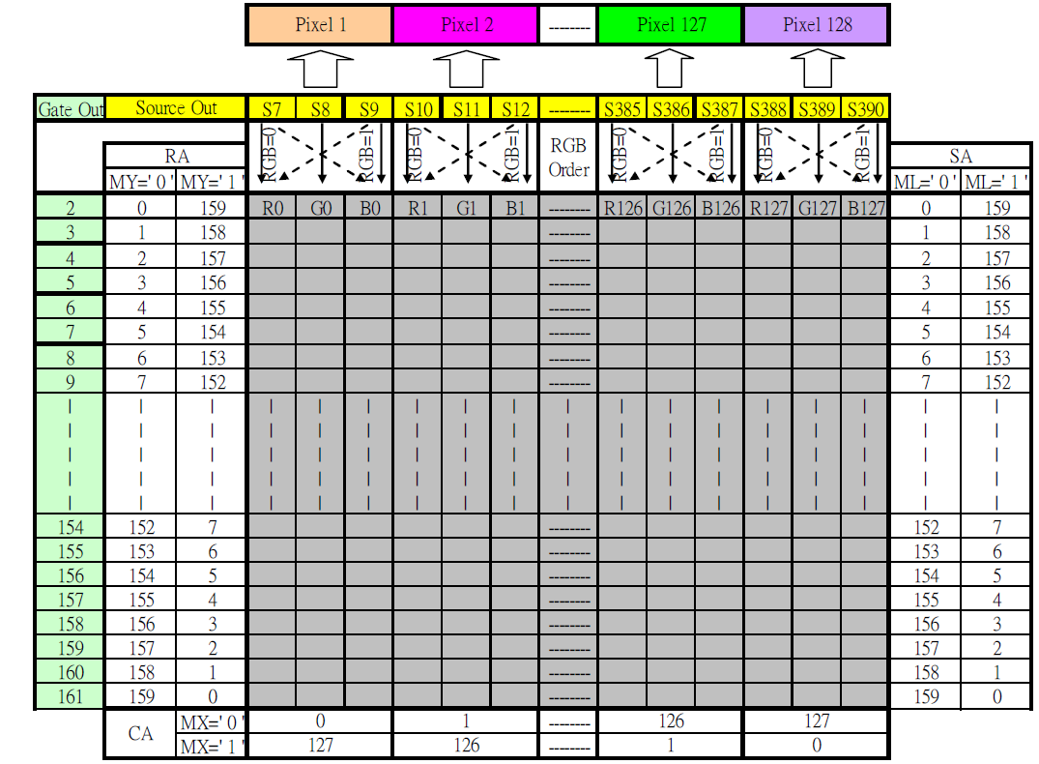
The ST7735R TFT LCD Controller/Driver

Slide 5
Set Clock Module To Use External 48 MHz Crystal
// Configure Flash wait-state to 1 for both banks 0 & 1
FLCTL->BANK0_RDCTL = (FLCTL->BANK0_RDCTL & ~(FLCTL_BANK0_RDCTL_WAIT_MASK)) |
FLCTL_BANK0_RDCTL_WAIT_1;
FLCTL->BANK1_RDCTL = (FLCTL->BANK0_RDCTL & ~(FLCTL_BANK0_RDCTL_WAIT_MASK)) |
FLCTL_BANK1_RDCTL_WAIT_1;
//Configure HFXT to use 48MHz crystal, source to MCLK & HSMCLK*
PJ->SEL0 |= BIT2 | BIT3; // Configure PJ.2/3 for HFXT function
PJ->SEL1 &= ~(BIT2 | BIT3);
CS->KEY = CS_KEY_VAL ; // Unlock CS module for register access
CS->CTL2 |= CS_CTL2_HFXT_EN | CS_CTL2_HFXTFREQ_6 | CS_CTL2_HFXTDRIVE;
while(CS->IFG & CS_IFG_HFXTIFG)
CS->CLRIFG |= CS_CLRIFG_CLR_HFXTIFG;
/* Select MCLK & HSMCLK = HFXT, no divider */
CS->CTL1 = CS->CTL1 & ~(CS_CTL1_SELM_MASK | CS_CTL1_DIVM_MASK | CS_CTL1_SELS_MASK | CS_CTL1_DIVHS_MASK) | CS_CTL1_SELM__HFXTCLK | CS_CTL1_SELS__HFXTCLK;
CS->KEY = 0; // Lock CS module from unintended accesses

Slide 6
Check Clock Signals After Setting in CS Module
After setting the clock signals, especially after setting up an external crystal oscillator verify that the clocks were set correctly
HINT: YOU can find it on Port 4 alternate functions

Slide 7
C
o
r
t
e
x
M
4
S
y
s
t
i
c
k
MSP432
Architecture
S
y
s
t
e
m
B
u
s
I
n
t
e
r
f
a
c
e
N
V
I
C
G
P
I
O
P
o
r
t
1
G
P
I
O
P
o
r
t
6
P
1
.
7
/
U
C
B
0
S
C
L
T
i
m
e
r
A
P
6
.
7
/
T
A
2
.
4
/
/
U
C
B
3
S
C
L
P
1
.
6
/
U
C
B
0
S
D
A
P
6
.
6
/
T
A
2
.
3
/
U
C
B
3
S
D
A
P
1
.
5
/
U
C
B
0
C
L
K
P
6
.
5
/
U
C
B
1
S
C
L
P
P
1
.
4
/
U
C
B
0
S
T
E
e
U
S
C
I
e
U
S
C
I
P
6
.
4
/
U
C
B
1
S
D
A
P
1
.
3
/
U
C
A
0
T
X
D
P
6
.
3
/
U
C
B
1
C
L
K
P
1
.
2
/
U
C
A
0
R
X
D
P
6
.
2
/
U
C
B
1
S
T
E
1
.
1
/
U
C
A
0
C
L
K
A
D
C
1
4
P
6
.
1
/
A
1
4
General-Purpose I/O (GPIO):
78 pins
10 ports
P
1
.
0
/
U
C
A
0
S
T
E
P
6
.
0
/
A
1
5
G
P
I
O
P
o
r
t
2
G
P
I
O
P
o
r
t
7
P
2
.
7
/
T
A
0
.
4
P
7
.
7
/
T
A
1
.
1
/
C
0
.
2
P
2
.
6
/
T
A
0
.
3
T
i
m
e
r
A
P
7
.
6
/
T
A
1
.
2
/
C
0
.
3
P
2
.
5
/
T
A
0
.
2
P
7
.
5
/
T
A
1
.
3
/
C
0
.
4
P
2
.
3
/
P
2
.
4
/
T
A
0
.
1
T
i
m
e
r
A
P
7
.
4
/
T
A
1
.
4
/
C
0
.
5
Pins are multiplexed between
std I/O and peripherals
P
2
.
2
/
U
C
A
1
T
X
D
P
7
.
3
/
T
A
0
.
0
P
2
.
1
U
C
A
1
R
X
D
e
U
S
C
I
P
7
.
2
/
C
1
O
U
T
/
T
A
1
C
L
K
P
2
.
/
U
C
A
1
C
L
K
P
7
.
1
/
C
0
O
U
T
/
T
A
0
C
L
K
0
/
U
C
A
1
S
T
E
P
7
.
0
/
S
M
C
L
K
/
D
M
A
E
0
G
P
I
O
P
o
r
t
3
G
P
I
O
P
o
r
t
8
Only 67 pins are available
P
3
.
7
/
U
C
B
2
S
C
L
P
8
.
7
/
A
1
8
P
3
.
6
/
U
C
B
2
S
D
A
A
D
C
1
4
P
8
.
6
/
A
1
9
P
3
.
5
/
U
C
B
2
C
L
K
P
8
.
5
/
A
2
0
P
P
3
.
4
/
U
C
B
2
S
T
E
e
U
S
C
I
P
8
.
4
/
A
2
1
P
3
.
3
/
U
C
A
2
T
X
D
T
i
m
e
r
A
P
8
.
3
/
T
A
3
C
L
K
/
A
2
2
3
.
2
/
U
C
A
2
R
X
D
P
8
.
2
/
T
A
3
.
2
/
A
2
3
P
3
.
1
/
U
C
A
2
C
L
K
e
U
S
C
I
P
8
.
1
/
U
C
B
3
C
L
K
/
T
A
2
.
0
Almost 32
ADC Channels
P
3
.
0
/
U
C
A
2
S
T
E
P
8
.
0
/
U
C
B
3
S
T
E
/
T
A
1
.
0
G
P
I
O
P
o
r
t
4
G
P
I
O
P
o
r
t
9
P
4
.
7
/
A
6
P
9
.
7
/
U
C
A
3
T
X
D
P
4
.
6
/
A
7
e
U
S
C
I
P
9
.
6
/
U
C
A
3
R
X
D
P
4
.
5
/
A
8
P
9
.
5
/
U
C
A
3
C
L
K
P
4
.
3
/
R
T
C
C
P
4
.
4
/
A
9
A
D
C
1
4
P
9
.
4
/
U
C
A
3
S
T
E
P
4
.
2
/
T
A
2
C
L
K
/
A
1
0
T
i
m
e
r
A
P
9
.
3
/
T
A
3
.
4
P
L
K
/
A
1
1
P
9
.
2
/
T
A
3
.
3
4
.
1
/
A
1
2
A
D
C
1
4
P
9
.
1
/
A
1
6
4
.
0
/
A
1
3
P
9
.
0
/
A
1
7
G
P
I
O
P
o
r
t
5
G
P
I
O
P
o
r
t
1
0
P1.0, P1.2, P1.3, P2.0, P2.1, P2.2,
P3.1, & P3.4 are available on jumpers,
P1.1, P1.4, P8.1 are not)
P
5
.
7
/
T
A
2
.
2
T
i
m
e
P
T
i
m
e
r
A
P
1
0
.
5
/
T
A
3
.
1
/
C
0
.
6
P
5
.
6
/
T
A
2
.
1
r
A
P
1
0
.
4
/
T
A
3
.
0
/
C
0
.
7
P
5
.
5
/
A
0
P
1
0
.
3
/
U
C
B
3
S
C
L
P
5
.
4
/
A
1
e
U
S
C
I
P
1
0
.
2
/
U
C
B
3
S
D
A
P
5
.
3
/
A
2
A
D
C
1
4
P
1
0
.
1
/
U
C
B
3
C
L
K
P
5
.
2
/
A
3
P
1
0
.
0
/
U
C
B
3
S
T
E
P
5
.
1
/
A
4
T
i
m
e
r32
P
5
.
0
/
A
5
P
e
r
i
p
h
e
r
a
l
B
u
s
R
T
C

Slide 8
Partial Table of Alternate Pin Functions
Default Primary Secondary Tertiary
Pin | PxSEL1=0, PxSEL0=0 | PxSEL1=0, PxSEL0=1 | PxSEL1=1, PxSEL0=0 | PxSEL1=1, PxSEL0=1
P1.0 | Port | UCA0STE
P1.1 | Port | UCA0CLK
P1.2 | Port | UCA0RXD/UCA0SOMI
P1.3 | Port | UCA0TXD/UCA0SIMO
P1.4 | Port | UCB0STE
P1.5 | Port | UCB0CLK
P1.6 | Port | UCB0SIMO/UCB0SDA
P1.7 | Port | UCB0SOMI/UCB0SCL
P2.0 | Port | UCA1STE
P2.1 | Port | UCA1CLK
P2.2 | Port | UCA1RXD/UCA1SOMI
P2.3 | Port | UCA1TXD/UCA1SIMO
P2.4 | Port | TA0.CCI1Aª / TA0.1^{b}
P2.5 | Port | TA0.CCI2Aª / TA0.2^{b}
P2.6 | Port | TA0.CCI3Aª / TA0.3^{b}
P2.7 | Port | TA0.CCI4Aª / TA0.4^{b}
P3.0 | Port | UCA2STE
P3.1 | Port | UCA2CLK
P3.2 | Port | UCA2RXD/UCA2SOMI
P3.3 | Port | UCA2TXD/UCA2SIMO
P3.4 | Port | UCB2STE
P3.5 | Port | UCB2CLK
P3.6 | Port | UCB2SIMO/UCB2SDA
P3.7 | Port | UCB2SOMI/UCB2SCL
P4.0 | Port |  |  | A13
P4.1 | Port |  |  | A12
P4.2 | Port | ACLK^{b} | TA2CLKª | A11
P4.3 | Port | MCLK^{b} | RTCCLK^{b} | A10
P4.4 | Port | HSMCLK^{b} | SVMHOUT^{b} | A9
P4.5 | Port |  |  | A8
P4.6 | Port |  |  | A7
P4.7 | Port |  |  | A6
MUX bits of
PxSEL0 & PxSEL1
General Purpose I/O
0
Table 4.1 in Valvano’s textbook
Primary Module Function
1
Secondary Module Function
2
Tertiary Module Function
3
Pin of Chip
SEL1 and SEL0 bits on the MSP432 specify alternate functions.
P1.2 and P1.3 are hardwired to the serial port to USB interface.
Dr. Nabeeh Kandalaft EGR226 Grand valley State University

Slide 9
Check Clock Signals After Setting in CS Module
After setting the clock signals, especially after setting up an external crystal oscillator verify that the clocks were set correctly
/* Step 4: Output MCLK to port pin to demonstrate 48MHz operation */
P4->DIR |= BIT3 | BIT4;
P4->SEL0 |= BIT3 | BIT4; // Output MCLK
P4->SEL1 &= ~ (BIT3 | BIT4);

Slide 10
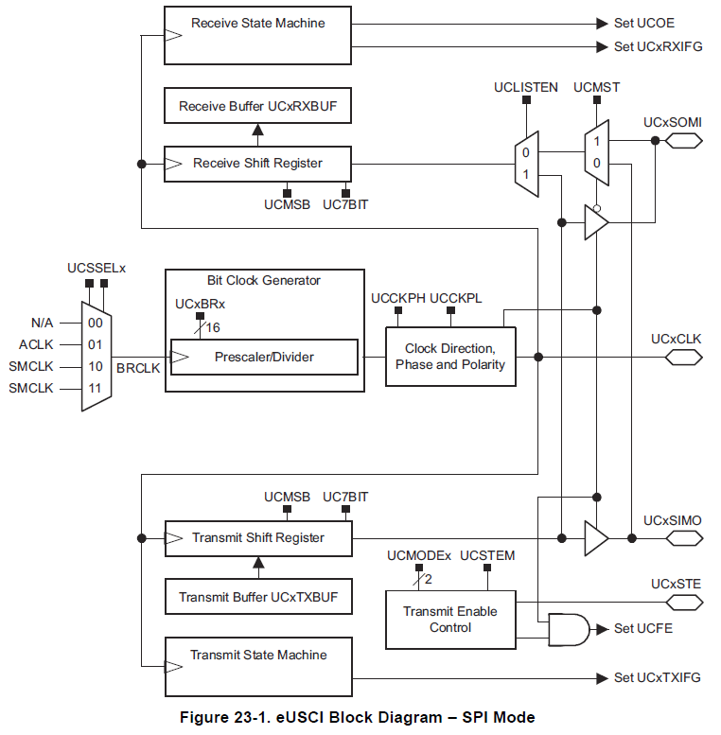
MSP432 eUSCI in SPI mode
This flexible hardware module can be configured to serve multiple purposes (serial, I²C, SPI)
SPI drivers monitor RXIFG and TXIFG to know when to read and write to buffers
Clock polarity and edge timing must be set properly to match slave device
from TI MSP432P4XX Family Techncal Reference Guide

Slide 11
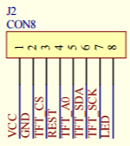
Basic Master Mode SPI C Code
The example code we’re suggesting you start with was written for a different implementation of a ST7735 module, therefore, there are some pin location and name differences.
// ST7735.c
// Runs on MSP432
// Low level drivers for the ST7735 160x128 LCD
// Backlight (pin 10) connected to +3.3 V ← pin 8, has a small series resistor
// MISO (pin 9) unconnected
// SCK (pin 8) connected to P9.5 (UCA3CLK) ← pin 7
// MOSI (pin 7) connected to P9.7 (UCA3SIMO) ← pin 6 *** labeled SDA ***
// TFT_CS (pin 6) connected to P9.4 (UCA3STE)← pin 3 labeled CS
// CARD_CS (pin 5) unconnected
// Data/Command (pin 4) connected to P9.2 (GPIO), high for data, low for command
← pin 5 *** labeled A0 ***
// RESET (pin 3) connected to P9.3 (GPIO) ← pin 4
// VCC (pin 2) connected to +3.3 V ← pin 1 *** be very careful not to switch VCC and GND !!!
// Gnd (pin 1) connected to ground ← pin 2
From ST7735.c, Adafruit library modified by Daniel Valvano (in the archive you can download from
http://edx-org-utaustinx.s3.amazonaws.com/UT601x/ValvanoWare.zip )

Slide 12
C code to control pixels on an LCD matrix display
Commands for initializing the controller
// toggle RST low to reset; CS low so it'll listen to us
// UCA3STE is temporarily used as GPIO
P9->SEL0 &= ~0x1C;
P9->SEL1 &= ~0x1C; // configure P9.2 (D/C), P9.3 (Reset), and P9.4 (TFT_CS) as GPIO
P9->DIR |= 0x1C; // make P9.2 (D/C), P9.3 (Reset), and P9.4 (TFT_CS) out
TFT_CS &=~ TFT_CS_BIT;
RESET |= RESET_BIT;
Delay1ms(500);
RESET &=~ RESET_BIT;
Delay1ms(500);
RESET |= RESET_BIT;
Delay1ms(500);
From ST7735.c, Adafruit library modified by Daniel Valvano

Slide 13
C code to control pixels on an LCD matrix display
Commands for initializing the eUSCI module in SPI mode
// initialize Eusci
EUSCI_A3->CTLW0 = 0x0001; // hold the eUSCI module in reset mode
// configure EUSCI_A3->CTLW0 for:
// bit15 EUSCI_A_CTLW0_CKPH = 1; data shifts in on first edge, out on following edge
// bit14 EUSCI_A_CTLW0_CKPL = 0; clock is low when inactive
// bit13 EUSCI_B_CTLW0_MSB = 1; MSB first
// bit12 EUSCI_B_CTLW0_SEVENBIT = 0; 8-bit data
// bit11 EUSCI_B_CTLW0_MST = 1; master mode
// bits10-9 UCMODEx = 2; UCSTE active low
// bit8 EUSCI_B_CTLW0_SYNC = 1; synchronous mode
// bits7-6 UCSSELx = 2; eUSCI clock SMCLK
// bits5-2 reserved
// bit1 EUSCI_B_CTLW0_STEM = 1; UCSTE pin enables slave
// bit0 EUSCI_A_CTLW0_SWRST = 1; reset enabled
EUSCI_A3->CTLW0 = 0xAD83;
From ST7735.c, Adafruit library modified by Daniel Valvano

Slide 14
C code to control pixels on an LCD matrix display
Commands for initializing the eUSCI module in SPI mode (con’t)
// set the baud rate for the eUSCI which gets its clock from SMCLK
// Clock_Init48MHz() from ClockSystem.c sets SMCLK = HFXTCLK/4 = 12 MHz
// if the SMCLK is set to 12 MHz, divide by 3 for 4 MHz baud clock
EUSCI_A3->BRW = 3;
// modulation is not used in SPI mode, so clear EUSCI_A3->MCTLW
EUSCI_A3->MCTLW = 0;
P9->SEL0 |= 0xB0;
P9->SEL1 &= ~0xB0; // configure P9.7, P9.5, and P9.4 as primary module function
P9->SEL0 &= ~0x0C;
P9->SEL1 &= ~0x0C; //configure P9.3 and P9.2 as GPIO (Reset and D/C pins)
P9->DIR |= 0x0C; // make P9.3 and P9.2 out (Reset and D/C pins)
EUSCI_A3->CTLW0 &= ~0x0001; // enable eUSCI module
EUSCI_A3->IE &= ~0x0003; // disable interrupts
From ST7735.c, Adafruit library modified by Daniel Valvano

Slide 15
C code to control pixels on an LCD matrix display
// This is a helper function that sends an 8-bit command to the LCD.
// Inputs: c 8-bit code to transmit
// Outputs: 8-bit reply
// Assumes: UCA3 and Port 9 have already been initialized and enabled
uint8_t static writecommand(uint8_t c) {
while((EUSCI_A3->IFG & 0x0002)==0x0000){}; // wait until EUSCI_A3->TXBUF empty
DC &= ~DC_BIT;
EUSCI_A3->TXBUF = c; // command out
while((EUSCI_A3->IFG &0x0001)==0x0000){}; // wait until EUSCI_A3->RXBUF full
return EUSCI_A3->RXBUF; // return the response
}
// This is a helper function that sends a piece of 8-bit data to the LCD.
// Inputs: c 8-bit data to transmit
// Outputs: 8-bit reply
// Assumes: UCA3 and Port 9 have already been initialized and enabled
uint8_t static writedata(uint8_t c) {
while((EUSCI_A3->IFG & 0x0002)==0x0000){}; //wait until EUSCI_A3->TXBUF empty
DC |= DC_BIT;
EUSCI_A3->TXBUF = c; // data out
while((EUSCI_A3->IFG & 0x0001)==0x0000){}; // wait until EUSCI_A3->RXBUF full
return EUSCI_A3->RXBUF; // return the response
}
From ST7735.c, Adafruit library modified by Daniel Valvano

Slide 16
Code to set up the ST7735 LCD Controller
Excerpt from commands for initializing the controller
static const uint8_t
Bcmd[] = { // Initialization commands for 7735B screens
18, // 18 commands in list:
ST7735_SWRESET, DELAY, // 1: Software reset, no args, w/delay
50, // 50 ms delay
ST7735_SLPOUT , DELAY, // 2: Out of sleep mode, no args, w/delay
255, // 255 = 500 ms delay
ST7735_COLMOD , 1+DELAY, // 3: Set color mode, 1 arg + delay:
0x05, // 16-bit color
10, // 10 ms delay
ST7735_FRMCTR1, 3+DELAY, // 4: Frame rate control, 3 args + delay:
0x00, // fastest refresh
0x06, // 6 lines front porch
0x03, // 3 lines back porch
10, // 10 ms delay
ST7735_MADCTL , 1 , // 5: Memory access ctrl (directions), 1 arg:
0x08, // Row addr/col addr, bottom to top refresh
ST7735_DISSET5, 2 , // 6: Display settings #5, 2 args, no delay:
0x15, // 1 clk cycle nonoverlap, 2 cycle gate
// rise, 3 cycle osc equalize
0x02, // Fix on VTL
ST7735_INVCTR , 1 , // 7: Display inversion control, 1 arg:
0x0, // Line inversion
⁞
From ST7735.c, Adafruit library modified by Daniel Valvano

Slide 17
Embedded Systems Design
When approaching embedded systems architecture design, several models can be applied to describe the design cycle.
The big-bang model:
there is essentially no planning or processes in place before and during
the development of a system.
The code-and-fix model:
product requirements are defined but no processes are in place
before the start of development.
The waterfall model:
there is a process for developing a system in steps, where results
of one step flow into the next step.
The spiral model:
there is a process for developing a system in steps, and throughout the various steps, feedback is obtained and incorporated back into the process.
Dr. Nabeeh Kandalaft EGR226 Grand valley State University

Slide 18
Structured Design
Requirements
Analysis
Requirements Document
Specification
Functional Specification
Hardware Architecture
Specification
Software Architecture
Specification
System
Architecture
Hardware
Design
Software
Design
Block Diagram
Module
Specification
Hardware
Implementation
Software
Implementation
Schematics,
Prototypes
Modules
Coded
Hardware
Testing
Software
Testing
Verified Hardware
System
Integration
Verified Software
Verified System
(does it work as designed?)
System
Validation
Validated System
(does it meet all requirements?)
Dr. Nabeeh Kandalaft EGR226 Grand valley State University

Slide 19
The System Requirements Specification (SyRS)
IEEE guidelines:
distinction between the system requirements (what the system must do, the SyRS) and process requirements (how to construct the system, the design document)
the SyRS provides a ‘black-box’ description of what the system must do, in terms of the system’s interactions or interfaces with its external environment.
the SyRS completely describes all inputs, outputs, and required relationships between inputs and outputs.
“a well-formed requirement is a statement of system functionality (a capability) that can be validated, that must be met or possessed by a system to solve a customer problem , and that is qualified by measurable conditions and bounded by constraints.”
from: IEEE Guide for Developing System Requirements Specifications, IEEE Std 1233, 1998 Edition

Slide 20
The SYstem Requirements Specification
Each requirement (numbered e.g., Req. 1) must possess the following properties:
a) Abstract. Each requirement must be implementation independent.
b) Unambiguous. Each requirement must be stated in such a way so that it can be interpreted in only one way.
c) Traceable. For each requirement it must be feasible to determine a relationship between specific documented customer statement(s) of need and the specific statements in the definition of the system given in the SyRS.
d) Verifiable Each requirement must have the means to prove that the system satisfies the requirements.
from: IEEE Guide for Developing System Requirements Specifications, IEEE Std 1233, 1998 Edition

Slide 21
Verification vs Validation
Validation: DONE FIRST!
Does your specification meet customer intent
Verification
Does your product meet the requirement
Test
Inspection
Analyze

Slide 22
The SYstem Requirements Specification
What you need to do:
Review the project description document
Get with your partner and decide what your design must accomplish
The core requirements use the key word “must”*, the extra features use the key word “may”
Number the requirements
Write the System Requirements Specification document with the following parts:
Introduction with purpose and goals of your embedded system
A block diagram showing the major components
A “walk through” of the user interface
A list of requirements written as described in the previous slide
A verification and validation plan
A timeline for the project with weekly milestones
*For an interesting discussion of legal terminiology, see http://www.faa.gov/about/initiatives/plain_language/articles/mandatory/

Slide 23
Developing a System Architecture
Describing an embedded system’s behavior
Unified Modeling Language (UML) was developed as a computer science standard to develop object oriented system design (and is used in other areas)
One tool, a state machine diagram (statechart), is used for modeling system behavior through finite state transitions.
This will be a useful tool in developing your embedded system design

Slide 24
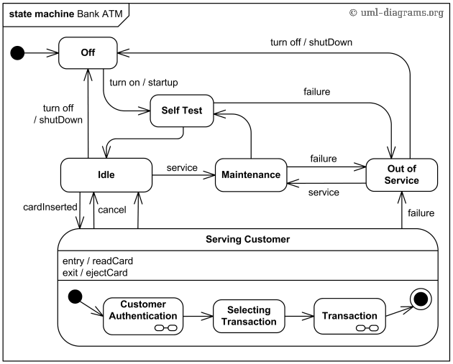
System Architecture – UML Statechart Diagram
state nodes connected with transitions triggered by events
models dynamic aspects of a system
models how the system reacts to inputs
describes different states of the system
defines a state machine to model the system

Slide 25
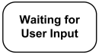
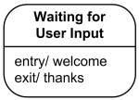
UML Behavioral State Machine
In extending the finite state machine structure
A state models a situation during which some condition holds.
a static situation such as an object waiting for some external event to occur.
the event is said to “trigger” an action
a dynamic conditions such as the process of performing some behavior.
enters the state when the behavior commences and leaves it as soon as the behavior is completed
The UML defines the following kinds of states:
simple state,
composite state.

Slide 26
UML Behavioral State Machine
A simple state is a state that does not have sub states.
Drawn as a rectangle with rounded corners and the state name inside the rectangle.
Simple state may have compartments:
name compartment
internal activities compartment
holds a list of internal actions or state activities that are performed while in the state
activity label identifies the circumstances under which the behavior will be invoked.

Slide 27
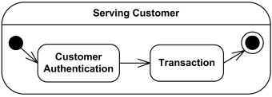
UML Behavioral State Machine
A composite state is defined as state that has sub states
Composite state will have the following:
name compartment
internal activities compartment
“decomposition compartment” (sub state sequence)
The first two compartments are the same as for simple state.
Decomposition refers to the nested structure of the state, diagrammed with internal states and transitions.

Slide 28
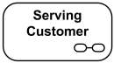
UML Behavioral State Machine
If a large number of states are inside a composite state, they may not fit in the graphical space available for the diagram.
In that case, use a simple state graphic with a special "composite" icon.
This icon is a visual cue that the state has a decomposition that is not shown.
The contents of the composite state are shown in a separate diagram (could be on a different page)

Slide 29
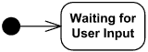
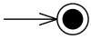
UML Behavioral State Machine
An initial pseudostate represents the symbol for a transition to the initial or default state.
An initial pseudostate is shown as a small solid filled circle.
Final state is a special kind of state signifying that the enclosing region (e.g., composite state) is completed.
E.g.,

Slide 30
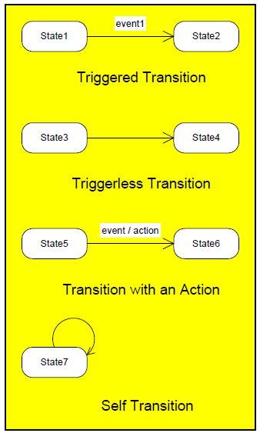
UML Behavioral State Machine
A transition is a directed relationship between a source state and a target state.
Transitions between states
Reflect change in system from one state to another
Expressed as an arrow directed from source to destination
Transition occurs when
Event of interest to system occurs (triggered transition)
System has completed some action and is ready to move to next state (triggerless transition)
An action may be associated with the the transition or it may be a transition to self

Slide 31
UML Behavioral State Machine
Top level state machine Bank ATM is initially turned off. After the power is turned on, ATM performs startup action and enters Self Test state.
If the test fails, ATM goes into Out of Service state, otherwise there is triggerless transition to the Idle state.
In this state ATM waits for customer interaction.
The ATM state changes from Idle to Serving Customer when the customer inserts banking or credit card in the ATM's card reader.
On entering the Serving Customer state, the entry action readCard is performed.
The transition from Serving Customer state back to the Idle state could be triggered by cancel event or final state
from http://www.uml-diagrams.org

Slide 32
UML Behavioral State Machine
Serving Customer state is a composite state with sequential sub states Customer Authentication, Selecting Transaction and Transaction.
Customer Authentication and Transaction are composite states by themselves which is shown with hidden decomposition indicator icon.
Serving Customer state has triggerless transition back to the Idle state after transaction is finished.
The state also has exit action ejectCard which releases customer's card on leaving the state, no matter what caused the transition out of the state.
from http://www.uml-diagrams.org

Slide 33
Describing a system as a state machine
List all possible states
Declare all variables
For each state, list possible transitions, with conditions, to other states
For each state and/or transition, list associated actions
For each state, ensure exclusive and complete exiting transition conditions
No two exiting conditions can be true at same time
Otherwise nondeterministic state machine
One condition must be true at any given time
Here’s a couple of examples of a free drawing tools to support making UML behavioral state diagrams
https://wiki.gnome.org/action/show/Apps/Dia?action=show&redirect=Dia
http://argouml.tigris.org/

Slide 34
Software Implementation of State Machine
#define S0 0
#define S1 1
...
#define SN N
void StateMachine() {
int state = S0; // or whatever is the initial state.
while (1) {
switch (state) {
case S0:
// Insert S0’s actions here & Insert transitions T_{i} leaving S0:
if( T₀’s condition is true ) {state = T₀’s next state; /*actions*/ }
if( T₁’s condition is true ) {state = T₁’s next state; /*actions*/ }
...
if( T_{m}’s condition is true ) {state = T_{m}’s next state; /*actions*/ }
break;
case S1:
// Insert S1’s actions here
// Insert transitions T_{i} leaving S1
break;
...
case SN:
// Insert SN’s actions here
// Insert transitions T_{i} leaving SN
break;
}
}
}

